Slide 1



Customer Segmentation Using K-means and Hierarchical Clustering
Unsupervised Learning for Targeted Marketing Strategies
Mehrdad Naderi
2024 - Fall 2
University of Colorado Boulder

Slide 2
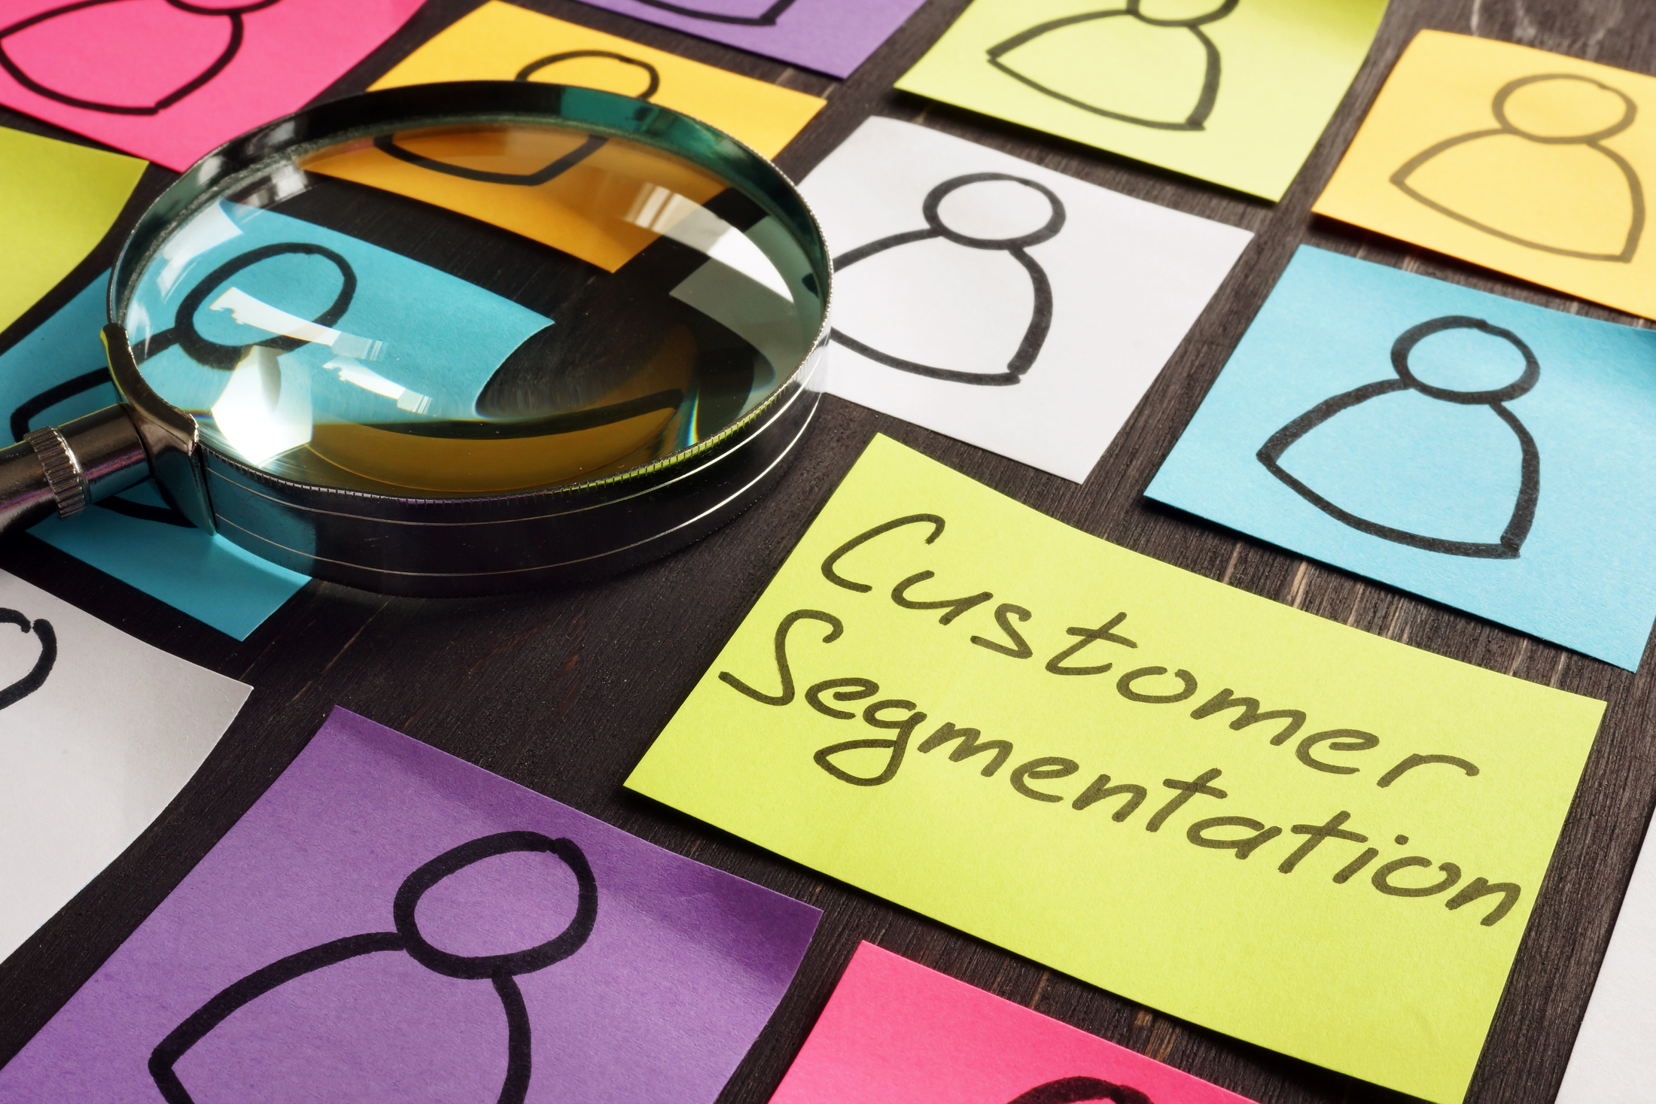

What is Customer Segmentation?
Grouping customers based on shared attributes.
Why Customer Segmentation Matters:
Personalized marketing.
Improved resource allocation.
Enhanced customer satisfaction.
Objective:
Identify meaningful customer groups using clustering techniques.

Slide 3

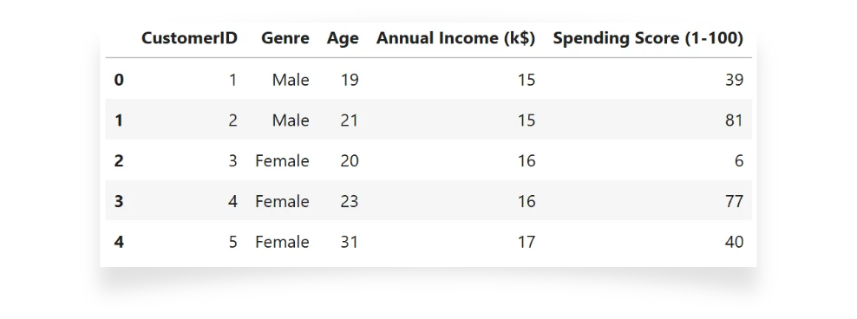
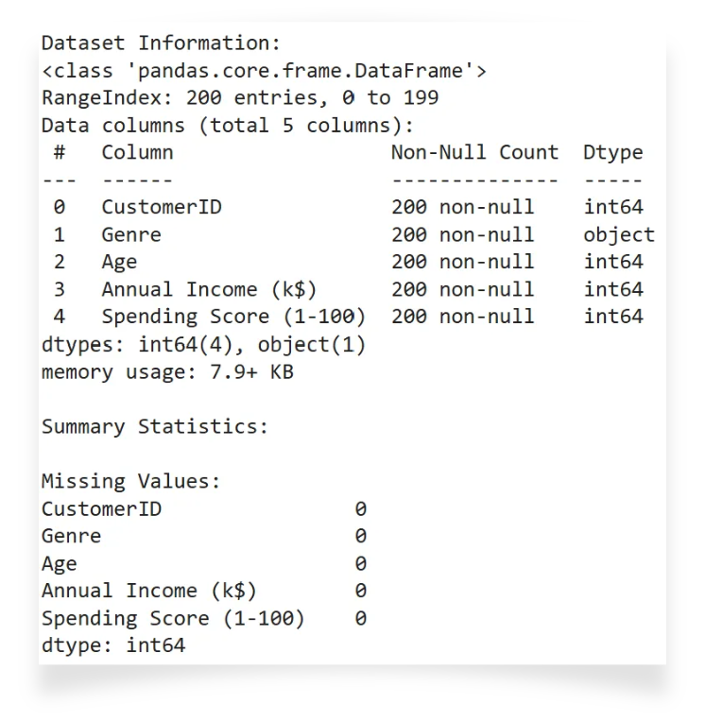
Dataset Description
Dataset Source:
Kaggle: Mall Customers Dataset.
Features:
Age, Gender, Annual Income, Spending Score.
Data Characteristics:
200 rows, no missing values.

Slide 4
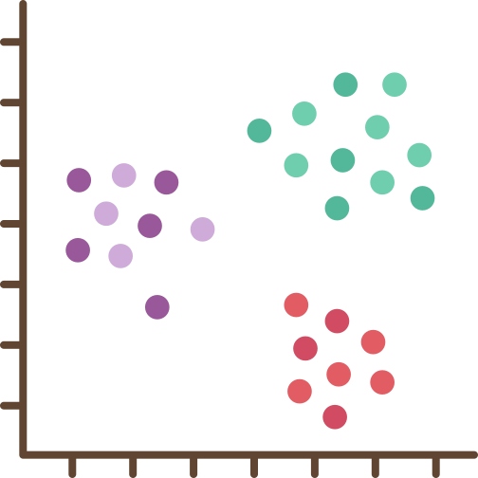
Problem:
"Group customers into clusters for targeted marketing strategies."
Clustering Techniques:
K-means and Hierarchical Clustering.
Goal:
Reveal patterns in customer spending and demographics.

Slide 5
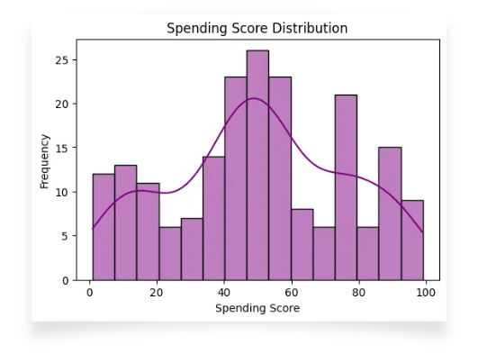

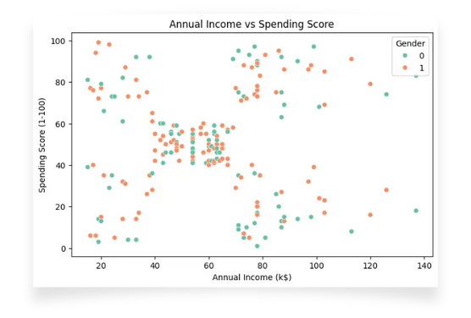
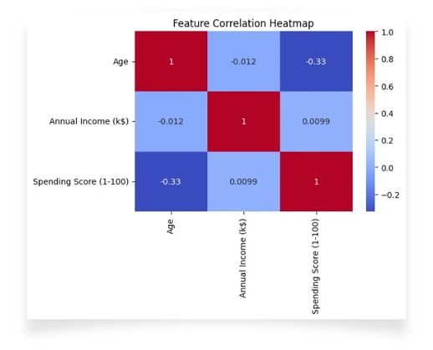
Insights from EDA:
Feature distributions:
Spending Score: "Most customers have moderate spending scores."
Income: "Annual Income ranges widely."
Relationships:
Income vs. Spending Score shows clear patterns for clustering.

Slide 6
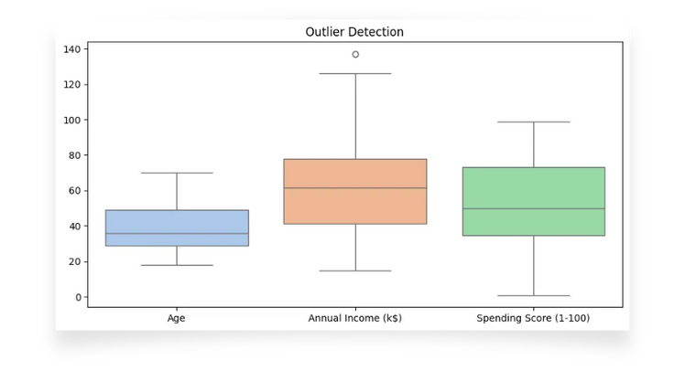


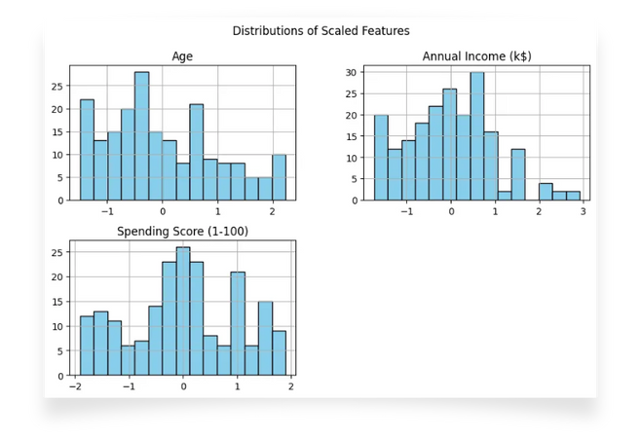
Outlier Handling:
Detected and capped outliers using IQR.
Feature Scaling:
Standardized numeric features to ensure equal weighting.

Slide 7
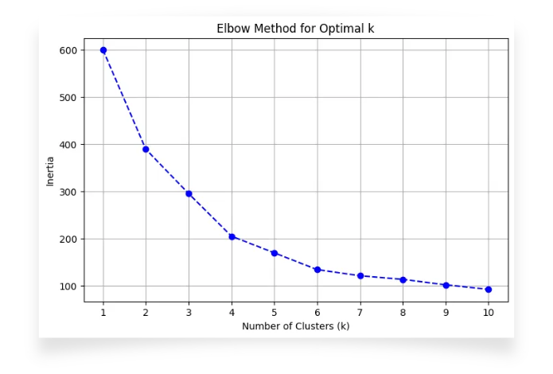

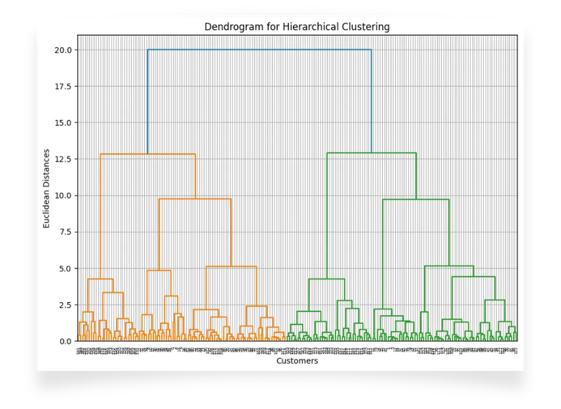
K-means Clustering:
"Finds clusters by minimizing within-cluster variance."
Optimization:
Elbow Method to determine optimal k.
Silhouette Score to validate clusters.
Hierarchical Clustering:
"Builds a hierarchy of clusters based on linkage.
" Ward's method used for merging clusters.

Slide 8

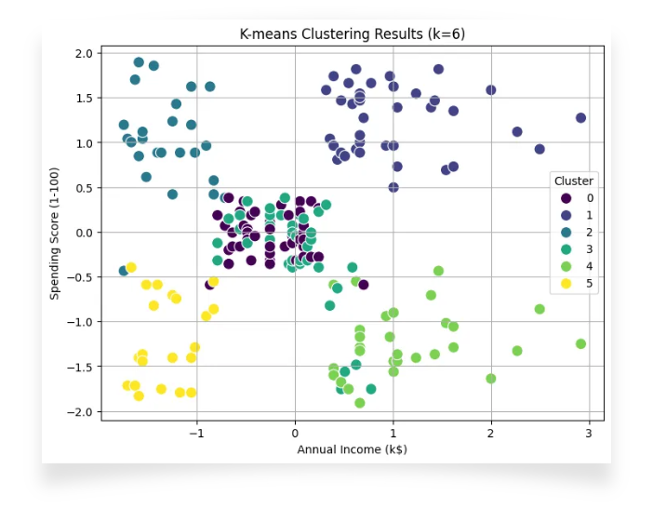
Optimal Clusters:
k=6.
Cluster Characteristics:
Cluster 1: High-income, high spenders
Cluster 2: Young, low-income, high spenders
Cluster 3: Middle-aged, low spenders, etc
Evaluation Metrics:
Silhouette Score: 0.431.

Slide 9
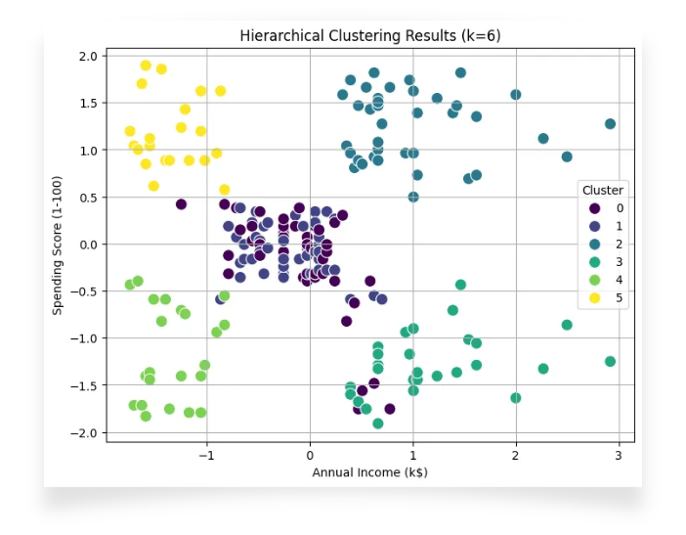

Cluster Characteristics:
Similar patterns to K-means clusters.
Evaluation Metrics:
Silhouette Score: 0.420.

Slide 10
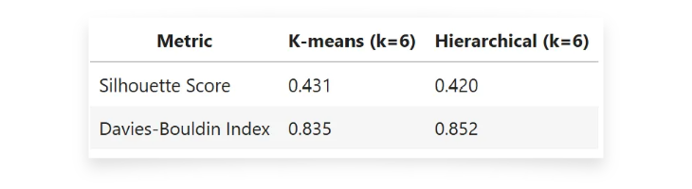
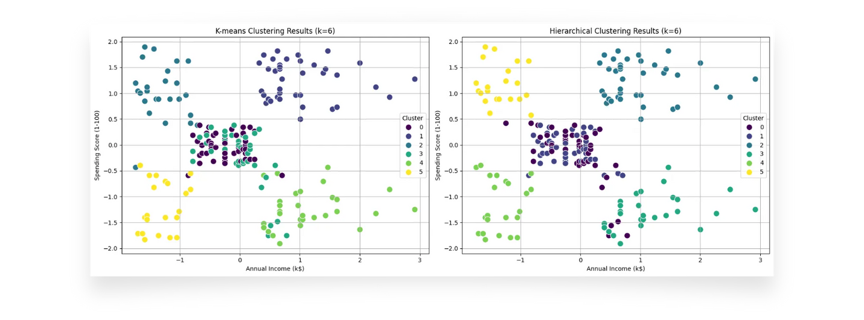
Metrics:
Preferred Model:
"K-means is preferred due to better performance and scalability."

Slide 11


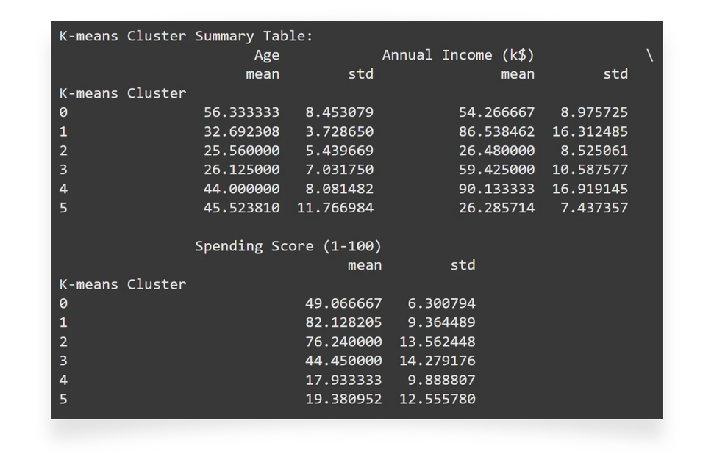
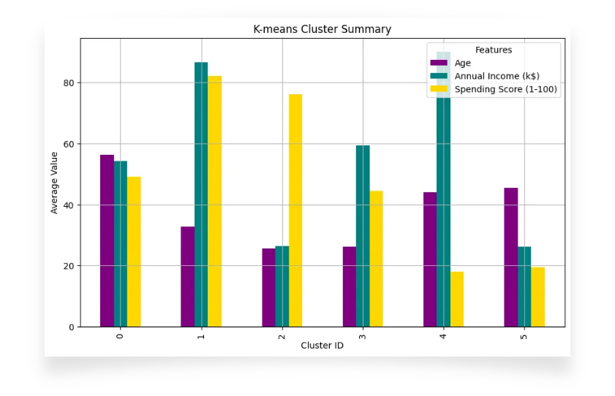
Cluster Summaries:
Cluster 1: "Target high spenders with premium offers.”
Cluster 5: "Provide cost-effective options to low-income groups.”
Actionable Insights:
"High-value clusters should receive personalized promotions."

Slide 12



Key Takeaways:
Clustering revealed actionable customer segments.
K-means performed slightly better than Hierarchical Clustering
Limitations:
Small dataset size.
Subjective Spending Score introduces bias.
Future Work:
Expand dataset with additional features.
Test other clustering methods (e.g., DBSCAN)

